Slide 1
Emotion(s) prediction
Kris Ng

Slide 2
Project Flow
Background & Problem Statement
01
04
Evaluation & Prediction
Dataset & EDA
02
05
Recommendation
Future Works
Modelling
03
06

Slide 3
Background
Over the past few years living with the pandemic, all of us have had to cut down on social gatherings and stayed home way more than we used to.

Slide 4
Problem Statement
With most of our time spent within the confines of the same four walls, it is no surprise our mental health has suffered¹. The cost of poor mental health is absenteeism and low productivity.
1) https://www.channelnewsasia.com/singapore/singapore-mental-health-awareness-stigma-conditions-depression-1973166

Slide 5

Problem Statement
As a natural consequence of the extended time spent at home, our presence on virtual platforms has increased sharply².
A department in the Mental Health Institute is looking into tapping on social media platforms to reach out to the public.
Goal: To construct a model that can detect the emotion(s) in comments.
2) https://www.ncbi.nlm.nih.gov/pmc/articles/PMC7280123/
Notes:
Invest in people’s mental health, early detection programs, show that society cares, economy will be positively impacted financially by less absenteeism, lower unemployment rate and have a happier, more productive workforce

Slide 6
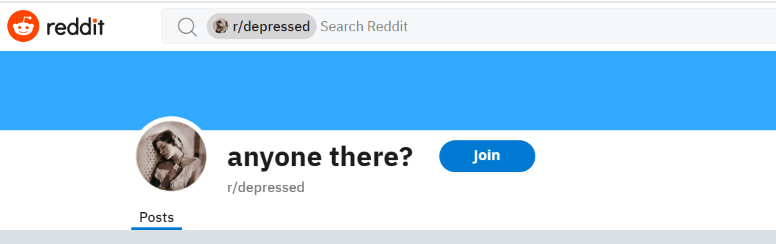
Dataset
author | created utc | body
hour of post
length of post

Slide 7
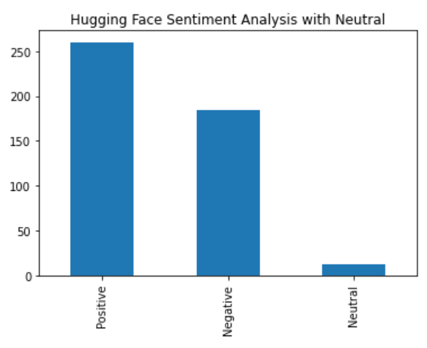
EDA – Tweet Sentiment Analyzer³
Body | Tweet Sentiment Analyzer by Adam Chell
Maybe the new therapist will be more helpful, you should at least give it a go. You don't know until you at least meet the new person. I'm sorry you feel so bad | Negative
Your mother is not overprotective, she is restrictive | Positive
3) https://huggingface.co/adam-chell/tweet-sentiment-analyzer

Slide 8
EDA – T5 Emotion Recognition⁴
Emotions | %
Joy | 46
Sadness | 31
Anger | 14
Fear | 6
Love | 2
Body | T5 Emotion Recognition
Maybe the new therapist will be more helpful, you should at least give it a go. You don't know until you at least meet the new person. I'm sorry you feel so bad | Sadness
Your mother is not overprotective, she is restrictive | Fear
4) https://huggingface.co/mrm8488/t5-small-finetuned-emotion

Slide 9
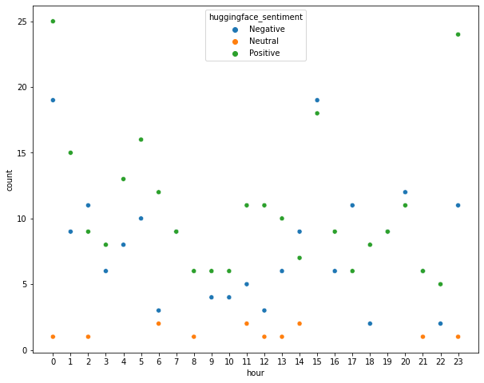
EDA – Time of comments
negative comments > positive from the midday mark at 1400
positive comments > negative in the morning hours
medical article⁵ - most people feel upbeat and energetic around noon but tend to have more negative feelings during the early afternoon or evening
5) https://www.webmd.com/bipolar-disorder/are-my-mood-swings-normal#:~:text=Many%20things%20can%20affect%20how,symptom%20of%20a%20mental%20illness
Notes:
Time - ‘created utc’
reddit is an international platform
users from different time zones
can't formulate any strong correlation between timing and the sentiment of the posts

Slide 10
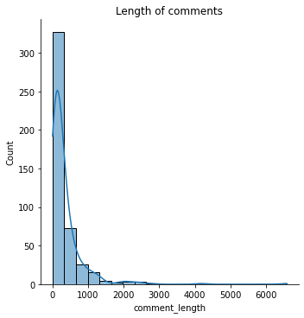
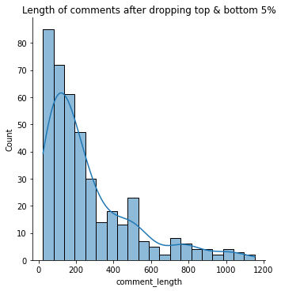
EDA - Length of comments
Notes:
Dropping top 5% to normalise data.

Slide 11
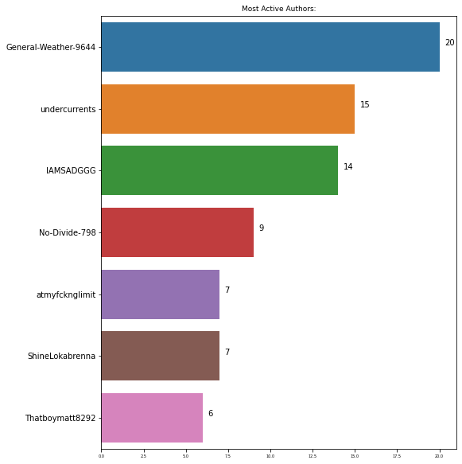
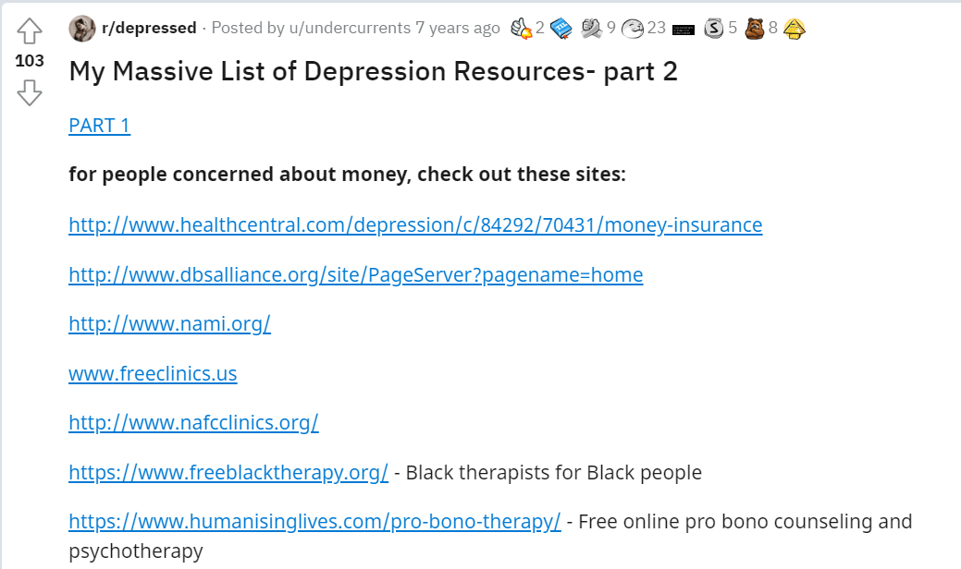
EDA - Authors
I think this is just a guy thing, I’m not very sociable either. Most of the time I just don’t bother with people, less trouble that way. | Joy
Yeh it looks like it’s mainly psychological, “Perhaps the most dangerous is intense depression, which can lead to an increased suicide risk.” Your probably going to need some help with this one. Do you have any mates you can count on? | Anger
Notes:
Study author posts. Akin to Project 3.
Top commenter - not just one to shoot negative comments to put others down.
2nd top commenter - seems to be a positive fella looking out to help others.

Slide 12
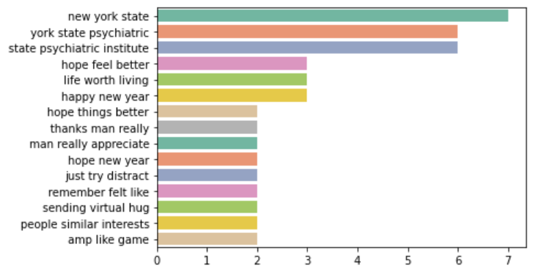
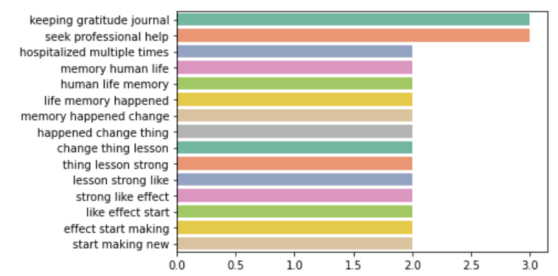
EDA - trigrams
Positive
Negative

Slide 13
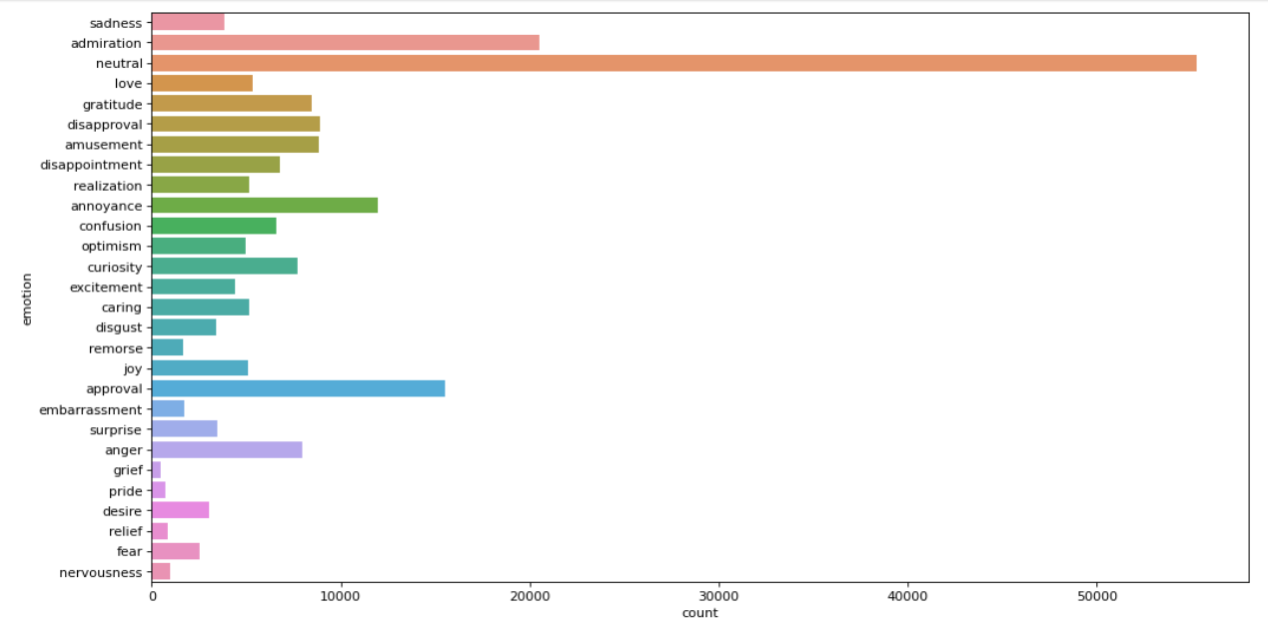
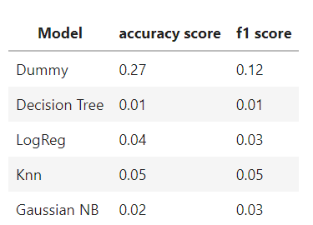
Modelling – Feature Engineering
Dataset from Hugging Face
(26 emotions + neutral)

Slide 14
Modelling – Feature Engineering
Emotions | % | Class weights
Neutral | 68 | 0.2
Anger | 10 | 1.5
Joy | 6 | 2.7
Sadness | 5 | 3.0
Surprise | 4 | 3.3
Disgust | 4 | 3.4
Fear | 3 | 4.6
Narrowed down to basic 6 emotions + neutral
Imbalanced data
Class_weights = ‘balanced’

Slide 15
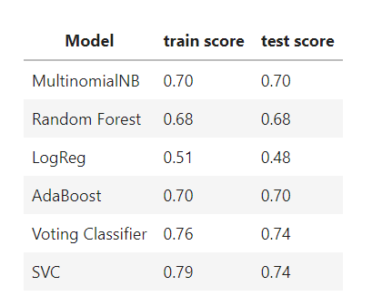
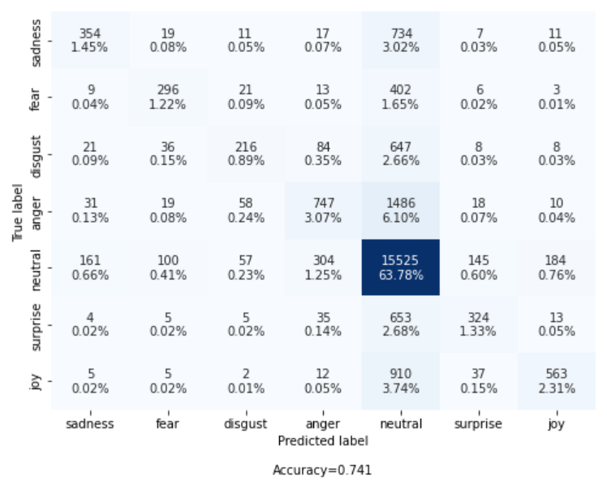
Model Evaluation
Imbalanced data
Class_weights = ‘balanced’
Notes:
SVC best performing.
True positives are decent but many wrongly predicted as ‘neutral’.

Slide 16
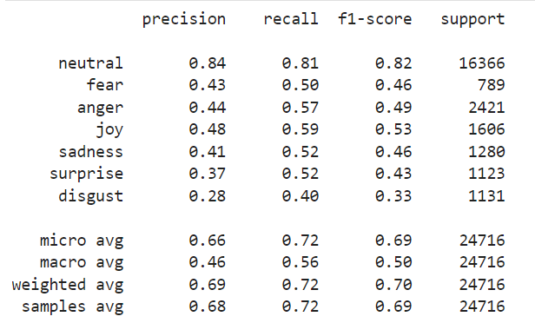
Multilabel Classification - OneVsRest Classifier (SVC)
Tvec_max_features | [1000, 3000, 5000]
Tvec_ngram_range | [(1,1), (1,2), (1,3)]
Train score | 0.75
Test score | 0.63

Slide 17
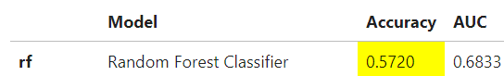
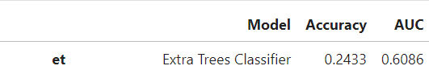
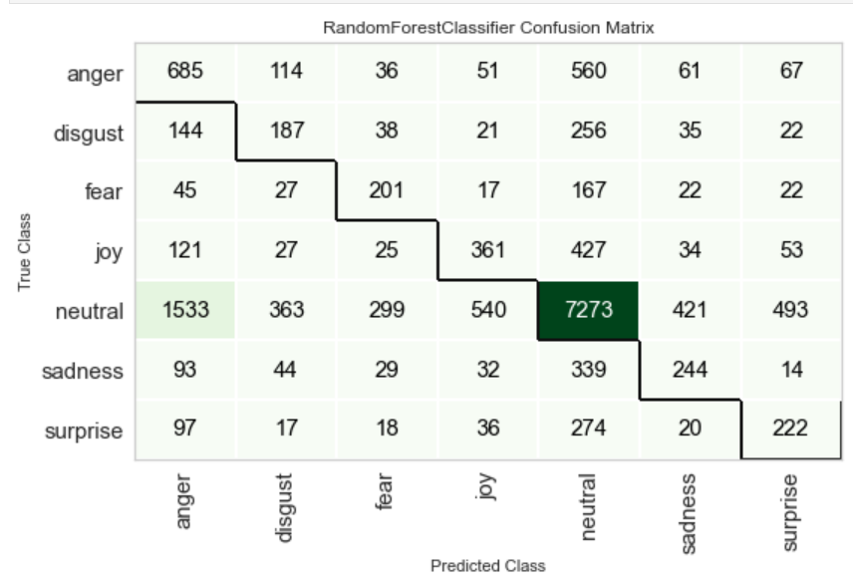
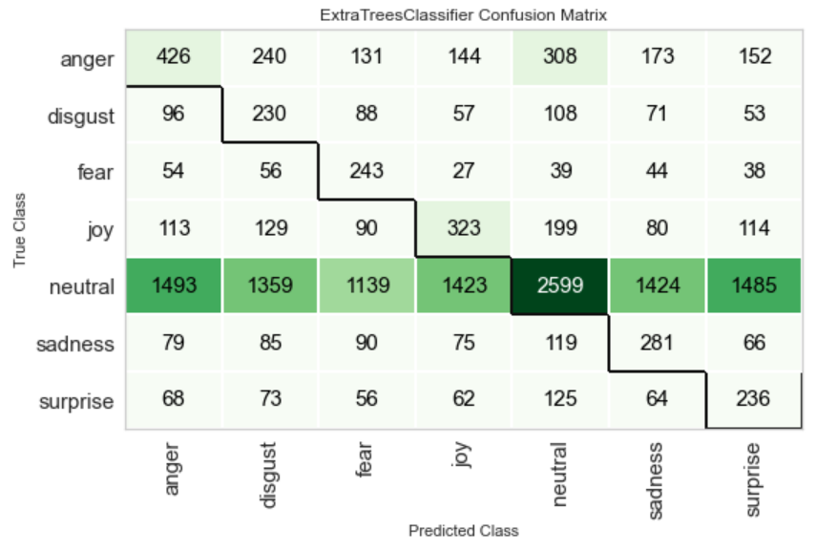
Pycaret
Fix imbalance=True | Fix imbalance method = RandomUnderSampler
Notes:
When set to True, SMOTE (Synthetic Minority Over-sampling Technique) is applied by default to create synthetic datapoints for minority class.

Slide 18
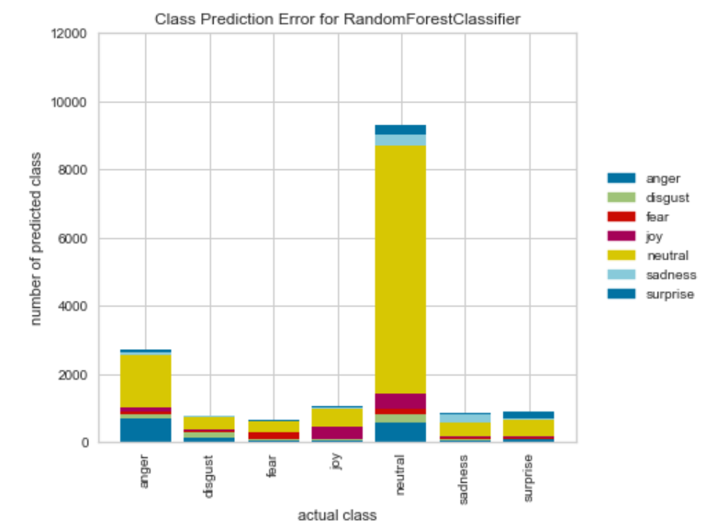
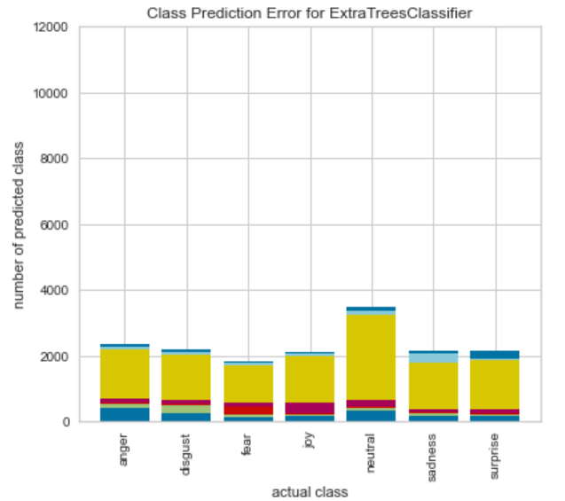
Pycaret
Fix imbalance=True | Fix imbalance method = RandomUnderSampler

Slide 19
Prediction – multiclass classification
Body | Predicted class
I'm sorry you feel like that . Have you tried therapy ? | Sadness
Thanks man I really do appreciate it . Glad everything worked out for you , and hopefully soon for me too . | Joy
Wow . I have never read such an accurate description of how I feel about myself . I hate being perceived and I hate acknowledging my own existence . You are not alone. | Anger
You sound exactly like me . I wonder how you are right now ? Did you manage to beat the brain fog and get your studies done ? | Surprise
Sounds horrible . I am truly sorry . Hope you find genuine happiness and peace in life. | Fear

Slide 20
Prediction – multilabel classification
Body | Predicted emotions
Thank you so much and me too | Joy, Surprise
You ’ re not a bad person ! Bad people can ’ t even see that they are being bad , I know how you feel but you ’ re not alone I promise | Disgust, Sadness
Damn what shitty friends and girlfriend . Sorry they made you feel worse . Hope someone comes along and genuinely shows you what a real friend is . | Anger, Sadness
I'm so sorry you had that , I'm always scared of being that guy and it's made me so self conscious I never complement people on looks . | Fear, Sadness

Slide 21
Recommendation
Recent ~50 comments
Detect emotion(s)
Identify main emotion(s)
User A
Comments made this week
Negative
Positive
Send encouragement quote/ message
Mildly negative
Provide resources
Activate chatbot
Send affirmation quote/ message
Moderately negative
Link up with professional help
Severely negative

Slide 22
Future Works
Model prediction | Deployment | Further refinements
Regularly train using new comments for updated topics of discussion/ economical trends | Study month when negativity peaks | Wider range of emotions
Drop ‘neutral’ class | Send positive messages in the morning | User-initiated application for self-check
Take comments of a specified length | Send encouragement messages in the evening | Multilabel classification by percentage
 | Build up resources | Cater to different age groups

Slide 23
MENTAL HEALTH INFOGRAPHICS
Mercury
Mars
Mercury is the closest planet to the Sun and the smallest one in the Solar System
Despite being red, Mars is actually a cold place. This planet is full of iron oxide dust
Venus
Neptune
Venus has a beautiful name and is the second planet from the Sun. It’s terribly hot
Neptune is the farthest planet from the Sun and the fourth-largest by diameter

Slide 24
MENTAL HEALTH INFOGRAPHICS
Mercury
Saturn
Mercury is the closest planet to the Sun and the smallest one
It's composed of hydrogen and helium. It was named after a Roman god
Mars
Venus
Despite being red, Mars is actually a cold place. It’s full of iron oxide dust
Venus has a beautiful name and is the second planet from the Sun
Jupiter
Neptune
Jupiter is a gas giant and the biggest planet in the Solar System
Neptune is the farthest planet from the Sun and the fourth-largest

Slide 25
MENTAL HEALTH INFOGRAPHICS
Mercury
Mars
Mercury is the closest planet to the Sun and the smallest one
Despite being red, Mars is a cold place. It’s full of iron oxide dust
Venus
Jupiter
Venus has a beautiful name and is the second planet from the Sun
It’s a gas giant and the biggest planet in the Solar System
Saturn
Neptune
Saturn is the ringed one. It’s composed mostly of hydrogen and helium
Neptune is the farthest planet from the Sun and the fourth-largest

Slide 26
MENTAL HEALTH INFOGRAPHICS
Mercury is the closest planet to the Sun and the smallest one in the Solar System
Despite being red, Mars is actually a cold place. It’s full of iron oxide dust
Venus has a beautiful name and is the second planet from the Sun
Jupiter is a gas giant, the fourth-brightest object in the sky and the biggest planet of them all
The planet’s name has nothing to do with the liquid metal since it was named after a Roman god

Slide 27
MENTAL HEALTH INFOGRAPHICS
Mercury is the closest planet to the Sun and the smallest
Despite being red, Mars is a cold place
Venus has a beautiful name and is the second planet
It’s a gas giant and the biggest planet in the Solar System
Saturn is a gas giant and has several rings
Neptune is the farthest planet from the Sun
Mars is a cold place

Slide 28
MENTAL HEALTH INFOGRAPHICS
Mercury
Mars
Mercury is the closest planet to the Sun
Despite being red, Mars is a really cold place
Venus
Jupiter
Venus has a beautiful name and is the second
It’s a gas giant and the biggest planet
Saturn
Neptune
Saturn is a gas giant and has several rings
Neptune is the farthest planet from the Sun

Slide 29
Project Flow
Build dashboard - predict current emotional state based on latest posts
Use PushShift API to scrap posts from Twitter and/or Reddit.
01
04
EDA and sentiment analysis
02
05
Provide recommendation of resources
Streamlit - for users to check in on own well being/ get help on own accord
Model - predict emotional state
03
06

Slide 30
MENTAL HEALTH INFOGRAPHICS
Mercury
Saturn
Mercury is the smallest closest planet to the Sun
Saturn is a gas giant and has several rings
7.5
Neptune
Millions
Jupiter
Neptune is the farthest planet from the Sun
It’s a gas giant and the biggest planet

Slide 31
MENTAL HEALTH INFOGRAPHICS
Mercury
Saturn
Venus
Jupiter
Mercury is the closest planet to the Sun and the smallest one
This ringed planet is composed of hydrogen and helium
Venus has a beautiful name and is the second planet from the Sun
Jupiter is a gas giant and the fourth-brightest object in the sky

Slide 32
MENTAL HEALTH INFOGRAPHICS
Mars
Despite being red, Mars is actually a cold place. It's full of iron oxide dust, which gives the planet its reddish cast
100
Jupiter
75
Jupiter is a gas giant, the biggest planet in the Solar System and the fourth-brightest object in the sky
50
Venus
25
Venus has a beautiful name and is the second planet from the Sun. It’s terribly hot
Neptune
Neptune is the farthest planet from the Sun and the fourth-largest by diameter in the Solar System

Slide 33
MENTAL HEALTH INFOGRAPHICS
Mercury
Mars
Mercury is the closest planet to the Sun
Despite being red, Mars is a cold place
Venus
Jupiter
Venus has a beautiful name and is the second
It’s a gas giant and the biggest planet
Saturn
Neptune
Saturn is a gas giant and has rings
Neptune is the farthest planet from the Sun

Slide 34
MENTAL HEALTH INFOGRAPHICS
1
Mercury
3
Venus
5
Jupiter
Mercury is the closest planet to the Sun
Venus has a beautiful name and is the second
It’s a gas giant and the biggest planet of them all
Saturn is a gas giant and has several rings
Mars is actually a cold place. It’s full of iron oxide dust
2
Saturn
4
Mars

Slide 35
MENTAL HEALTH INFOGRAPHICS
75%
25%
Despite being red, Mars is actually a cold place. This planet is full of iron oxide dust
Jupiter is a gas giant, the biggest planet in the Solar System and the fourth-brightest
50%
15%
Venus has a beautiful name and is the second planet from the Sun. It’s terribly hot
Neptune is the farthest planet from the Sun and the fourth-largest by diameter in the Solar System

Slide 36
MENTAL HEALTH INFOGRAPHICS
Mercury
Mars
Saturn
Mercury is the closest planet to the Sun
Despite being red, Mars is a cold place
Saturn is a gas giant and has rings
Venus
Neptune
Jupiter
Venus is the second planet from the Sun
Neptune is the farthest planet from the Sun
It’s a gas giant and the biggest planet

Slide 37
MENTAL HEALTH INFOGRAPHICS
Despite being red, Mars is actually a cold place
Mercury is the closest planet to the Sun and the smallest
It’s a gas giant and the biggest planet in the Solar System
Venus has a beautiful name and is the second planet
Neptune is the farthest planet from the Sun

Slide 38
MENTAL HEALTH INFOGRAPHICS
1
2
3
4
Mercury is the closest planet to the Sun and the smallest one
Venus has a beautiful name and is the second planet from the Sun
Saturn, the ringed one, is composed mostly of hydrogen and helium
Neptune is the farthest planet from the Sun and the fourth-largest
MERCURY
VENUS
SATURN
NEPTUNE

Slide 39
MENTAL HEALTH INFOGRAPHICS
Mercury
Venus
Saturn
Neptune
Mars
Mercury is the smallest planet in the Solar System
Venus has a beautiful name and is the second planet
Saturn is a gas giant and has several rings
Neptune is the farthest planet from the Sun
Despite being red, Mars is actually a cold place

Slide 40
MENTAL HEALTH INFOGRAPHICS
Mercury
Mercury is the closest planet to the Sun and the smallest one in the Solar System
Venus
Venus has a beautiful name and is the second planet from the Sun. It's terribly hot, even hotter than Mercury
Saturn
Saturn is a gas giant and has several rings. It's composed mostly of hydrogen and helium
Mars
Despite being red, Mars is actually a cold place. It's full of iron oxide dust, which gives the planet its reddish cast

Slide 41
MENTAL HEALTH INFOGRAPHICS
Mercury
Venus
Saturn
Mars
Mercury is the closest planet to the Sun and the smallest one
Venus has a beautiful name and is the second planet from the Sun
Saturn, the ringed one, is composed of hydrogen and helium
Despite being red, Mars is actually a cold place. It's full of iron oxide dust

Slide 42
MENTAL HEALTH INFOGRAPHICS
Mercury is the closest planet to the Sun and the smallest
Venus has a beautiful name and is the second planet
Saturn is composed mostly of hydrogen and helium
It’s a gas giant and the biggest planet in the Solar System

Slide 43
MENTAL HEALTH INFOGRAPHICS
Mercury
Venus
Saturn
Mercury is the closest planet to the Sun and the smallest one in the Solar System
Venus has a beautiful name and is the second planet from the Sun. It's terribly hot
Saturn is a gas giant and has several rings. It's composed of hydrogen and helium

Slide 44
MENTAL HEALTH INFOGRAPHICS
Mercury
Mars
Mercury is the smallest planet
Despite being red, Mars is a cold place
Venus
Jupiter
Venus has a beautiful name
It’s a gas giant and the biggest planet
Saturn
Neptune
Saturn is a gas giant and has rings
Neptune is the farthest planet

Slide 45
MENTAL HEALTH INFOGRAPHICS
Mercury is the closest planet to the Sun and the smallest
Venus has a beautiful name and is the second planet
Saturn is composed mostly of hydrogen and helium
It’s a gas giant and the biggest planet in the Solar System

Slide 46
MENTAL HEALTH INFOGRAPHICS
25%
75%
15%
50%
Mercury is the closest planet to the Sun and the smallest one
Venus has a beautiful name, but also a poisonous atmosphere
Saturn, the ringed one, is composed of hydrogen and helium
It’s a gas giant and the biggest planet in the Solar System

Slide 47
MENTAL HEALTH INFOGRAPHICS
Mercury is the closest planet to the Sun and the smallest
Despite being red, Mars is a cold place full of iron oxide dust
Venus has a beautiful name and is the second planet
It’s a gas giant and the biggest planet in the Solar System
Saturn is composed mostly of hydrogen and helium
Neptune is the farthest planet from the Sun

Slide 48
MENTAL HEALTH INFOGRAPHICS
Despite being red, Mars is a cold place
Mars
Saturn is a gas giant and has rings
Saturn
Mercury is the closest planet to the Sun
Venus
Venus is the second planet from the Sun
Mercury

Slide 49
MENTAL HEALTH INFOGRAPHICS
Venus
Jupiter
Venus has a beautiful name and is the second planet from the Sun
Jupiter is a gas giant, the biggest planet in the Solar System
Mercury
Mars
Saturn
Mercury is the closest planet to the Sun and the smallest one
Despite being red, Mars is a cold place. It’s full of iron oxide dust
Saturn is composed mostly of hydrogen and helium

Slide 50
MENTAL HEALTH INFOGRAPHICS
Mercury is the closest planet to the Sun and the smallest one in the Solar System
Venus has a beautiful name and is the second planet from the Sun. It’s terribly hot
Despite being red, Mars is a cold place. It’s full of iron oxide dust
50%
75%
25%

Slide 51
MENTAL HEALTH INFOGRAPHICS
Despite being red, Mars is a cold place
Mercury is the closest planet to the Sun
Saturn is a gas giant and has rings
Venus is the second planet from the Sun
Neptune is the farthest planet
Yes, this is the ringed one. It’s a gas giant

Slide 52
Instructions for use (free users)
In order to use this template, you must credit Slidesgo by keeping the Thanks slide.
You are allowed to:
Modify this template.
Use it for both personal and commercial purposes.
You are not allowed to:
Sublicense, sell or rent any of Slidesgo Content (or a modified version of Slidesgo Content).
Distribute this Slidesgo Template (or a modified version of this Slidesgo Template) or include it in a database or in any other product or service that offers downloadable images, icons or presentations that may be subject to distribution or resale.
Use any of the elements that are part of this Slidesgo Template in an isolated and separated way from this Template.
Delete the “Thanks” or “Credits” slide.
Register any of the elements that are part of this template as a trademark or logo, or register it as a work in an intellectual property registry or similar.
For more information about editing slides, please read our FAQs or visit Slidesgo School:
https://slidesgo.com/faqs and https://slidesgo.com/slidesgo-school

Slide 53
Instructions for use (premium users)
In order to use this template, you must be a Premium user on Slidesgo.
You are allowed to:
Modify this template.
Use it for both personal and commercial purposes.
Hide or delete the “Thanks” slide and the mention to Slidesgo in the credits.
Share this template in an editable format with people who are not part of your team.
You are not allowed to:
Sublicense, sell or rent this Slidesgo Template (or a modified version of this Slidesgo Template).
Distribute this Slidesgo Template (or a modified version of this Slidesgo Template) or include it in a database or in any other product or service that offers downloadable images, icons or presentations that may be subject to distribution or resale.
Use any of the elements that are part of this Slidesgo Template in an isolated and separated way from this Template.
Register any of the elements that are part of this template as a trademark or logo, or register it as a work in an intellectual property registry or similar.
For more information about editing slides, please read our FAQs or visit Slidesgo School:
https://slidesgo.com/faqs and https://slidesgo.com/slidesgo-school

Slide 54
Infographics
You can add and edit some infographics to your presentation to show your data in a visual way.
Choose your favourite infographic and insert it in your presentation using Ctrl C + Ctrl V or Cmd C + Cmd V in Mac.
Select one of the parts and ungroup it by right-clicking and choosing “Ungroup”.
Change the color by clicking on the paint bucket.
Then resize the element by clicking and dragging one of the square-shaped points of its bounding box (the cursor should look like a double-headed arrow). Remember to hold Shift while dragging to keep the proportions.
Group the elements again by selecting them, right-clicking and choosing “Group”.
Repeat the steps above with the other parts and when you’re done editing, copy the end result and paste it into your presentation.
Remember to choose the “Keep source formatting” option so that it keeps the design. For more info, please visit Slidesgo School.

Slide 55
MENTAL HEALTH INFOGRAPHICS
Despite being red, Mars is actually a cold place
Mercury is the closest planet to the Sun and the smallest
It’s a gas giant and the biggest planet in the Solar System
Venus has a beautiful name and is the second planet
Neptune is the farthest planet from the Sun

Slide 56
MENTAL HEALTH INFOGRAPHICS
Mercury
Mars
Mercury is the closest planet to the Sun and the smallest one in the Solar System
Despite being red, Mars is actually a cold place. This planet is full of iron oxide dust
Venus
Neptune
Venus has a beautiful name and is the second planet from the Sun. It’s terribly hot
Neptune is the farthest planet from the Sun and the fourth-largest by diameter

Slide 57
MENTAL HEALTH INFOGRAPHICS
Mercury
Saturn
Mercury is the closest planet to the Sun and the smallest one
It's composed of hydrogen and helium. It was named after a Roman god
Mars
Venus
Despite being red, Mars is actually a cold place. It’s full of iron oxide dust
Venus has a beautiful name and is the second planet from the Sun
Jupiter
Neptune
Jupiter is a gas giant and the biggest planet in the Solar System
Neptune is the farthest planet from the Sun and the fourth-largest

Slide 58
MENTAL HEALTH INFOGRAPHICS
Mercury
Mars
Mercury is the closest planet to the Sun and the smallest one
Despite being red, Mars is a cold place. It’s full of iron oxide dust
Venus
Jupiter
Venus has a beautiful name and is the second planet from the Sun
It’s a gas giant and the biggest planet in the Solar System
Saturn
Neptune
Saturn is the ringed one. It’s composed mostly of hydrogen and helium
Neptune is the farthest planet from the Sun and the fourth-largest

Slide 59
MENTAL HEALTH INFOGRAPHICS
Mercury is the closest planet to the Sun and the smallest one
Despite being red, Mars is a cold place. It’s full of iron dust
Earth is the third planet from the Sun and the one where we live on
Neptune is the fourth-largest planet in the Solar System
Saturn is the ringed one. It’s composed mostly of hydrogen and helium
It’s a gas giant and the biggest planet in the Solar System

Slide 60
MENTAL HEALTH INFOGRAPHICS
Mercury is the closest planet to the Sun and the smallest one in the Solar System
Despite being red, Mars is actually a cold place. It’s full of iron oxide dust
Venus has a beautiful name and is the second planet from the Sun
Jupiter is a gas giant, the fourth-brightest object in the sky and the biggest planet of them all
The planet’s name has nothing to do with the liquid metal since it was named after a Roman god

Slide 61
MENTAL HEALTH INFOGRAPHICS
Mercury is the closest planet to the Sun and the smallest
Despite being red, Mars is a cold place
Venus has a beautiful name and is the second planet
It’s a gas giant and the biggest planet in the Solar System
Saturn is a gas giant and has several rings
Neptune is the farthest planet from the Sun
Mars is a cold place

Slide 62
MENTAL HEALTH INFOGRAPHICS
Mercury
Mars
Mercury is the closest planet to the Sun
Despite being red, Mars is a really cold place
Venus
Jupiter
Venus has a beautiful name and is the second
It’s a gas giant and the biggest planet
Saturn
Neptune
Saturn is a gas giant and has several rings
Neptune is the farthest planet from the Sun

Slide 63
Project Flow
Build dashboard - predict current emotional state based on latest posts
Use PushShift API to scrap posts from Twitter and/or Reddit.
01
04
EDA and sentiment analysis
02
05
Provide recommendation of resources
Streamlit - for users to check in on own well being/ get help on own accord
Model - predict emotional state
03
06

Slide 64
MENTAL HEALTH INFOGRAPHICS
Mercury
Saturn
Mercury is the smallest closest planet to the Sun
Saturn is a gas giant and has several rings
7.5
Neptune
Millions
Jupiter
Neptune is the farthest planet from the Sun
It’s a gas giant and the biggest planet

Slide 65
MENTAL HEALTH INFOGRAPHICS
Mercury
Saturn
Venus
Jupiter
Mercury is the closest planet to the Sun and the smallest one
This ringed planet is composed of hydrogen and helium
Venus has a beautiful name and is the second planet from the Sun
Jupiter is a gas giant and the fourth-brightest object in the sky

Slide 66
MENTAL HEALTH INFOGRAPHICS
Mars
Despite being red, Mars is actually a cold place. It's full of iron oxide dust, which gives the planet its reddish cast
100
Jupiter
75
Jupiter is a gas giant, the biggest planet in the Solar System and the fourth-brightest object in the sky
50
Venus
25
Venus has a beautiful name and is the second planet from the Sun. It’s terribly hot
Neptune
Neptune is the farthest planet from the Sun and the fourth-largest by diameter in the Solar System

Slide 67
MENTAL HEALTH INFOGRAPHICS
Mercury
Mars
Mercury is the closest planet to the Sun
Despite being red, Mars is a cold place
Venus
Jupiter
Venus has a beautiful name and is the second
It’s a gas giant and the biggest planet
Saturn
Neptune
Saturn is a gas giant and has rings
Neptune is the farthest planet from the Sun

Slide 68
MENTAL HEALTH INFOGRAPHICS
1
Mercury
3
Venus
5
Jupiter
Mercury is the closest planet to the Sun
Venus has a beautiful name and is the second
It’s a gas giant and the biggest planet of them all
Saturn is a gas giant and has several rings
Mars is actually a cold place. It’s full of iron oxide dust
2
Saturn
4
Mars

Slide 69
MENTAL HEALTH INFOGRAPHICS
75%
25%
Despite being red, Mars is actually a cold place. This planet is full of iron oxide dust
Jupiter is a gas giant, the biggest planet in the Solar System and the fourth-brightest
50%
15%
Venus has a beautiful name and is the second planet from the Sun. It’s terribly hot
Neptune is the farthest planet from the Sun and the fourth-largest by diameter in the Solar System

Slide 70
MENTAL HEALTH INFOGRAPHICS
Mercury
Mars
Saturn
Mercury is the closest planet to the Sun
Despite being red, Mars is a cold place
Saturn is a gas giant and has rings
Venus
Neptune
Jupiter
Venus is the second planet from the Sun
Neptune is the farthest planet from the Sun
It’s a gas giant and the biggest planet

Slide 71
MENTAL HEALTH INFOGRAPHICS
Despite being red, Mars is actually a cold place
Mercury is the closest planet to the Sun and the smallest
It’s a gas giant and the biggest planet in the Solar System
Venus has a beautiful name and is the second planet
Neptune is the farthest planet from the Sun

Slide 72
MENTAL HEALTH INFOGRAPHICS
1
2
3
4
Mercury is the closest planet to the Sun and the smallest one
Venus has a beautiful name and is the second planet from the Sun
Saturn, the ringed one, is composed mostly of hydrogen and helium
Neptune is the farthest planet from the Sun and the fourth-largest
MERCURY
VENUS
SATURN
NEPTUNE

Slide 73
MENTAL HEALTH INFOGRAPHICS
Mercury
Venus
Saturn
Neptune
Mars
Mercury is the smallest planet in the Solar System
Venus has a beautiful name and is the second planet
Saturn is a gas giant and has several rings
Neptune is the farthest planet from the Sun
Despite being red, Mars is actually a cold place

Slide 74
MENTAL HEALTH INFOGRAPHICS
Mercury
Mercury is the closest planet to the Sun and the smallest one in the Solar System
Venus
Venus has a beautiful name and is the second planet from the Sun. It's terribly hot, even hotter than Mercury
Saturn
Saturn is a gas giant and has several rings. It's composed mostly of hydrogen and helium
Mars
Despite being red, Mars is actually a cold place. It's full of iron oxide dust, which gives the planet its reddish cast

Slide 75
MENTAL HEALTH INFOGRAPHICS
Mercury
Venus
Saturn
Mars
Mercury is the closest planet to the Sun and the smallest one
Venus has a beautiful name and is the second planet from the Sun
Saturn, the ringed one, is composed of hydrogen and helium
Despite being red, Mars is actually a cold place. It's full of iron oxide dust

Slide 76
MENTAL HEALTH INFOGRAPHICS
Mercury is the closest planet to the Sun and the smallest
Venus has a beautiful name and is the second planet
Saturn is composed mostly of hydrogen and helium
It’s a gas giant and the biggest planet in the Solar System

Slide 77
MENTAL HEALTH INFOGRAPHICS
Mercury
Venus
Saturn
Mercury is the closest planet to the Sun and the smallest one in the Solar System
Venus has a beautiful name and is the second planet from the Sun. It's terribly hot
Saturn is a gas giant and has several rings. It's composed of hydrogen and helium

Slide 78
MENTAL HEALTH INFOGRAPHICS
Mercury
Mars
Mercury is the smallest planet
Despite being red, Mars is a cold place
Venus
Jupiter
Venus has a beautiful name
It’s a gas giant and the biggest planet
Saturn
Neptune
Saturn is a gas giant and has rings
Neptune is the farthest planet

Slide 79
MENTAL HEALTH INFOGRAPHICS
Mercury is the closest planet to the Sun and the smallest
Venus has a beautiful name and is the second planet
Saturn is composed mostly of hydrogen and helium
It’s a gas giant and the biggest planet in the Solar System

Slide 80
MENTAL HEALTH INFOGRAPHICS
25%
75%
15%
50%
Mercury is the closest planet to the Sun and the smallest one
Venus has a beautiful name, but also a poisonous atmosphere
Saturn, the ringed one, is composed of hydrogen and helium
It’s a gas giant and the biggest planet in the Solar System

Slide 81
MENTAL HEALTH INFOGRAPHICS
Mercury is the closest planet to the Sun and the smallest
Despite being red, Mars is a cold place full of iron oxide dust
Venus has a beautiful name and is the second planet
It’s a gas giant and the biggest planet in the Solar System
Saturn is composed mostly of hydrogen and helium
Neptune is the farthest planet from the Sun

Slide 82
MENTAL HEALTH INFOGRAPHICS
Despite being red, Mars is a cold place
Mars
Saturn is a gas giant and has rings
Saturn
Mercury is the closest planet to the Sun
Venus
Venus is the second planet from the Sun
Mercury

Slide 83
MENTAL HEALTH INFOGRAPHICS
Venus
Jupiter
Venus has a beautiful name and is the second planet from the Sun
Jupiter is a gas giant, the biggest planet in the Solar System
Mercury
Mars
Saturn
Mercury is the closest planet to the Sun and the smallest one
Despite being red, Mars is a cold place. It’s full of iron oxide dust
Saturn is composed mostly of hydrogen and helium

Slide 84
MENTAL HEALTH INFOGRAPHICS
Mercury is the closest planet to the Sun and the smallest one in the Solar System
Venus has a beautiful name and is the second planet from the Sun. It’s terribly hot
Despite being red, Mars is a cold place. It’s full of iron oxide dust
50%
75%
25%

Slide 85
MENTAL HEALTH INFOGRAPHICS
Despite being red, Mars is a cold place
Mercury is the closest planet to the Sun
Saturn is a gas giant and has rings
Venus is the second planet from the Sun
Neptune is the farthest planet
Yes, this is the ringed one. It’s a gas giant

Slide 86
Instructions for use (premium users)
In order to use this template, you must be a Premium user on Slidesgo.
You are allowed to:
Modify this template.
Use it for both personal and commercial purposes.
Hide or delete the “Thanks” slide and the mention to Slidesgo in the credits.
Share this template in an editable format with people who are not part of your team.
You are not allowed to:
Sublicense, sell or rent this Slidesgo Template (or a modified version of this Slidesgo Template).
Distribute this Slidesgo Template (or a modified version of this Slidesgo Template) or include it in a database or in any other product or service that offers downloadable images, icons or presentations that may be subject to distribution or resale.
Use any of the elements that are part of this Slidesgo Template in an isolated and separated way from this Template.
Register any of the elements that are part of this template as a trademark or logo, or register it as a work in an intellectual property registry or similar.
For more information about editing slides, please read our FAQs or visit Slidesgo School:
https://slidesgo.com/faqs and https://slidesgo.com/slidesgo-school

Slide 87
Infographics
You can add and edit some infographics to your presentation to show your data in a visual way.
Choose your favourite infographic and insert it in your presentation using Ctrl C + Ctrl V or Cmd C + Cmd V in Mac.
Select one of the parts and ungroup it by right-clicking and choosing “Ungroup”.
Change the color by clicking on the paint bucket.
Then resize the element by clicking and dragging one of the square-shaped points of its bounding box (the cursor should look like a double-headed arrow). Remember to hold Shift while dragging to keep the proportions.
Group the elements again by selecting them, right-clicking and choosing “Group”.
Repeat the steps above with the other parts and when you’re done editing, copy the end result and paste it into your presentation.
Remember to choose the “Keep source formatting” option so that it keeps the design. For more info, please visit Slidesgo School.

